Slide 1
Employee Attrition Rate

Slide 2
What’s important about Employee Attrition?
With the prevalence of remote work it is easy for employees to change companies. There are many hidden costs of hiring a new employee, which makes turnover very expensive for all companies.
Based on data collected by Human Resources, are we able to predict the factors that cause an employee to leave the company?

Slide 3
Data and Technologies
Data Source: IBM Human Resources data collected across the company
https://github.com/IBM/employee-attrition-aif360/blob/master/data/emp_attrition.csv
Technologies used:
Jupyter Notebook
Python
Pandas
Numpy
Matplotlib
Seaborn
Tableau
PostgreSQL

Slide 4
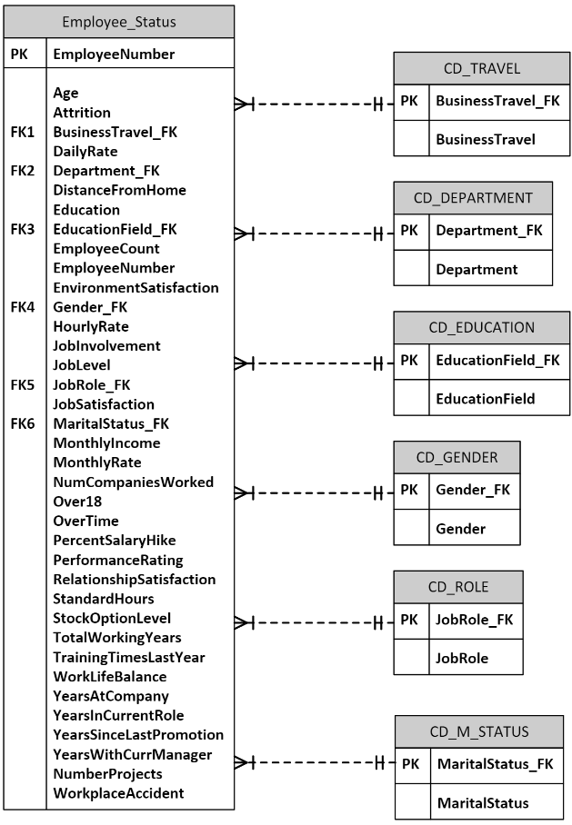
Entity Relational Diagram

Slide 5
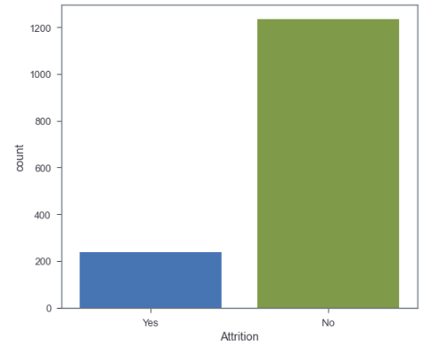
Data Exploration
Clean data
Check columns/nulls: 37 columns
Explore data types
Count target variable values
Attrition – No: 1233
Attrition – Yes: 237

Slide 6
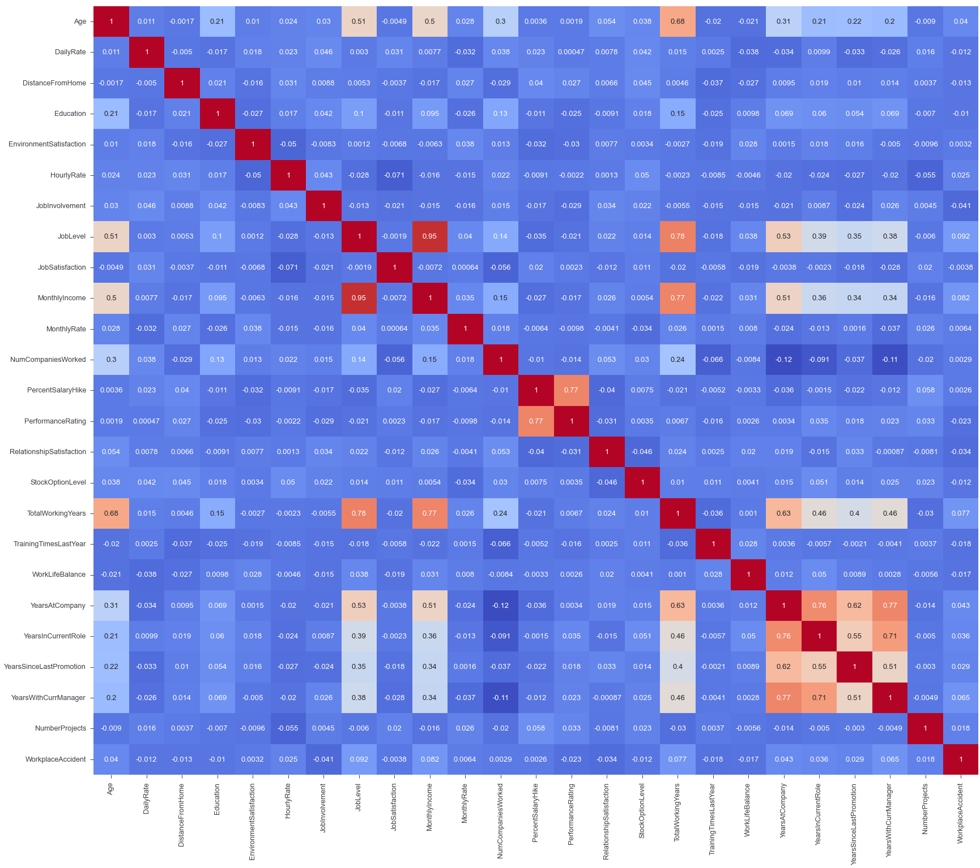
Data Exploration
Examine correlations between features

Slide 7
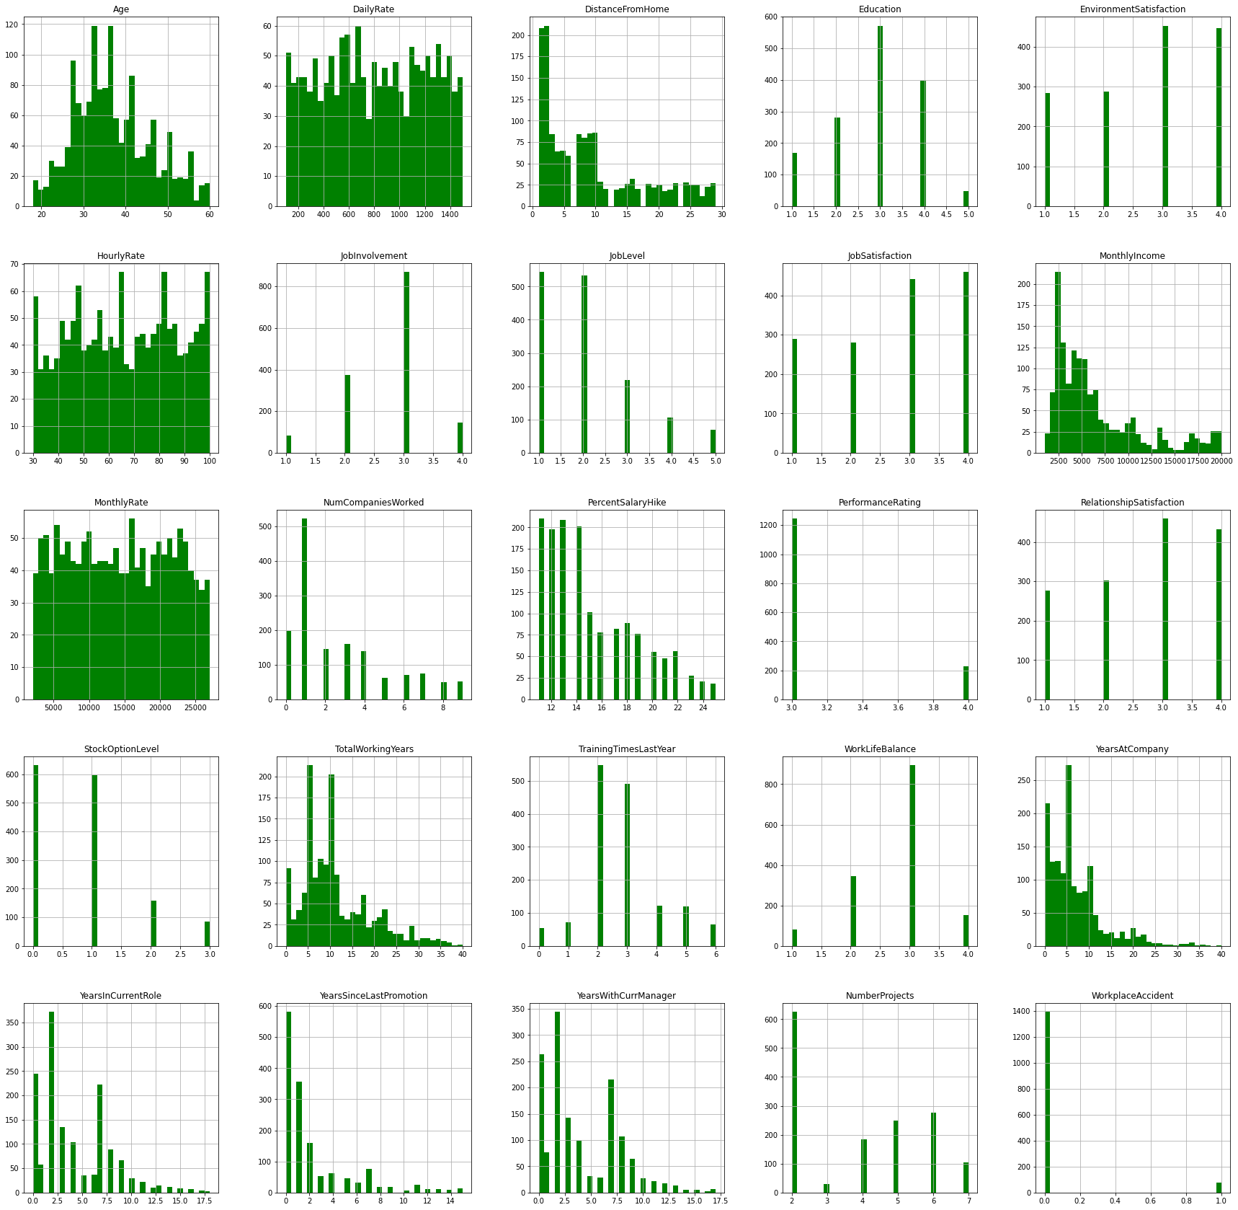
Data Exploration
Examine distribution of numerical features

Slide 8
Preliminary Feature Selection
Eliminate columns that are not useful: 4 columns dropped
ID numbers
Columns with 1 unique value

Slide 9
Data Processing
Transform categorical columns using OneHotEncoder
8 of 33 columns transformed
Split data into feature & target
Target: ‘Attrition_Yes’
Split using train_test_split
Scaling: StandardScaler

Slide 10
Data Processing
Split data shapes:
X_train (1176, 53)
X_test (294, 53)
y_train (1176,)
y_test (294,)

Slide 11
Machine Learning Models Evaluated
Model | Accuracy Score | Tuned Accuracy Score
Logistic Regression | 87.228% | 89.796%
Random Forest Classifier | 87.772% | 86.735%
Support Vector Machine | 87.228% | 89.116%
XG Boost | 88.315% | 87.755%
Naïve Bayes | 71.467% | 62.585%
Notes:
Model
Accuracy Score
Logistic Regression
87.228%
Random Forest Classifier
87.772%
Support Vector Machine
87.228%
XG Boost
88.315%
Naïve Bayes
71.467%

Slide 12
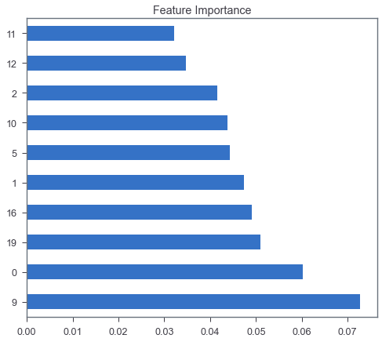
Additional Feature Selection: Logistic Regression Feature Importance
NumCompaniesWorked
PercentSalaryHike
DistanceFromHome
MonthlyRate
HourlyRate
DailyRate
TotalWorkingYears
YearsAtCompany
Age
MonthlyIncome

Slide 13
Recommendation for Future Analysis
Explore parameter tuning options
Feature reduction

Slide 14
Anything the team would have done differently?
Try additional models
Explore additional hyperparameter tuning options
Play with modifying variables

Slide 15
Dashboard Creation
https://github.com/lykkelig/Group6_Final_Project/tree/Erik_branch/Web

Slide 16
Visualizations
https://public.tableau.com/app/profile/erik.svoboda/viz/EmployeeAttrition_16528352408970/FinalProject?publish=yes

